Slide 1
Introduction to Software Engineering
Module 1
Introduction
Dr. Shai Koenig
Open University
Department of Computer Science
Office: 03-6452639

Slide 2
Introduction to
“Introduction to Software Engineering”
Topics
What is software ?
The problematics of software development
What is software engineering ?
Software development life cycle models
Software development process framework

Slide 3
What is software ?
Software is a collection of items that include
source code
object modules
command procedures
data
users manuals
requirements specifications
interface specifications
design descriptions
test plans
test procedures
management plans
defect reports
enhancement requests
evolution information
...
Software is not just sequences of programming language statements that do something useful !!!
Software is one of the company’s major assets !!!

Slide 4
Software Classifications
application type
...
system
business
engineering/scientific
real-time, embedded
personal computing
internet
artificial intelligence
...

Slide 5
Software Classifications
application type
attributes
single-user vs multi-user
sequential, concurrent, distributed
timing: batch, interactive, reactive
data persistence: none, low, high
transformations: simple -> complex
reliability: low -> high
hw proximity: low -> high

Slide 6
Software Classifications
application type
attributes
customer
...
Commodity
  “out-of-the-box”
  requires tailoring efforts
custom built
  in-house
  contracted/subcontracted...

Slide 7
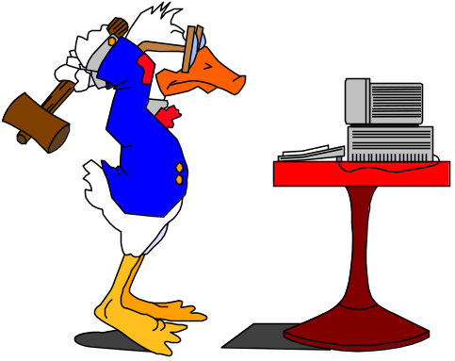


Problematics of software development
Quality
  incorrect
  incomplete
  unreliable
  poor performance
  unmaintainable
  …
Cost
  costs to much
  over budget
Time
  takes too long
  schedule overruns

Slide 8
Software complexity
Product complexity
  parts
  connections
  unstructured
  versions
  details
  …
Process complexity
  participants
  time
  conflicting goals
  fluidity
    requirements
    technology
    participants

Slide 9
Software Poses Challenges
How do we ensure the quality of the software that we produce ?
How do we meet growing demand and still maintain budget control ?
How do we avoid disastrous time delays ?
How do we successfully infuse newer software development technologies ?
How do we improve our software development capabilities ?
How do we upgrade an aging “software plant” ?

Slide 10
What is engineering ?
Basic
Science
scale
time
costs
Product
quality

Slide 11
Engineering disciplines consist of
quality
assurance
life cycle
models
tools
management
disciplines
development
activities
basic
science
mathematics
configuration
management
development
techniques

Slide 12
Key software development activities
software requirements analysis and specification
software design
software construction
software integration and testing
release and installation
maintenance
principles
methods
standards
technologies
notations
tools
inputs
Activity
outputs

Slide 13
Software life cycle models
Structured set of activities required to develop a software system
  selection of the activities
  ordering/sequencing the selected activities
Activities will vary depending on the development organization and the type of system being developed
Must be explicitly modeled if it is to be managed

Slide 14
Generic software life cycle models
The waterfall model
Evolutionary/incremental development
Prototyping
Component assembly model
Formal transformation

Slide 15
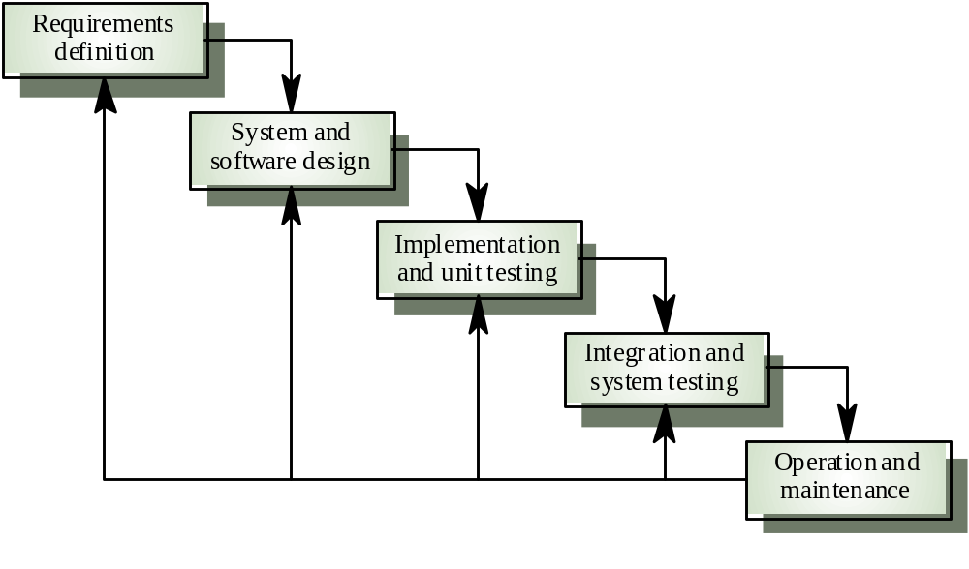
Waterfall [linear sequential] model
  High risk of falling into the requirements “tarpit”
  “all or nothing”
  requires customer “patience”
  Low risk for well-understood systems using familiar technology

Slide 16
The Waterfall Model
SW
Requirements
System Test
Planning
System
Testing
Architectural
Design
Integ. Test
Planning
Integration
Testing
Detailed
Design
Unit
Testing
Construction

Slide 17
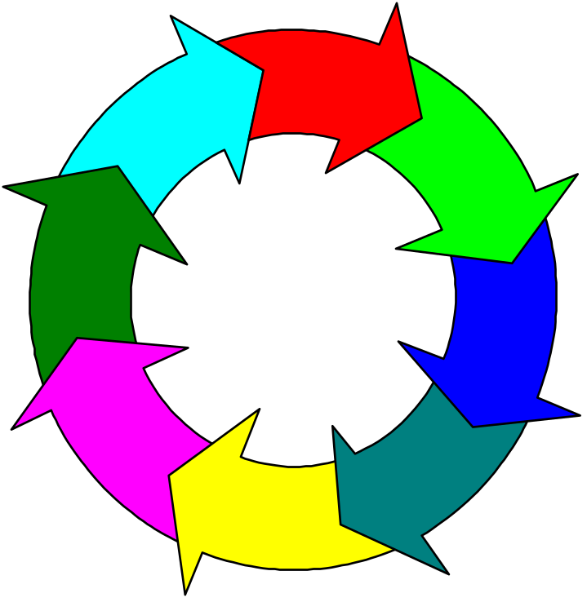

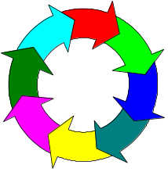
Evolutionary/Incremental Development Model
Software
Requirements
incremental approach
grows in response to user feedback
original design decisions may not support future increments
Architectural
Design
Maintenance
& Support
Software
Release
Construction
Validation
Testing
Integration & Testing
V1
Documentation
V2
V3
Notes:
3
8
NOTES
This slide illustrates the key software development activities constituting the corporate, generic software development lifecycle.
This lifecycle shows the activities that are performed in the development of a single release of a software product. This lifecycle is repeated for each release.
Within a single release these activities may not necessarily be performed in a purely sequential manner. Often such activities overlap or are interleaved. For example, software architectural design is often interleaved with requirements analysis and specification. Another example - validation testing involves test planning as well as test execution. Such validation test planning should be begin while requirements are being specified and continue as development progresses through design and construction.

Slide 18
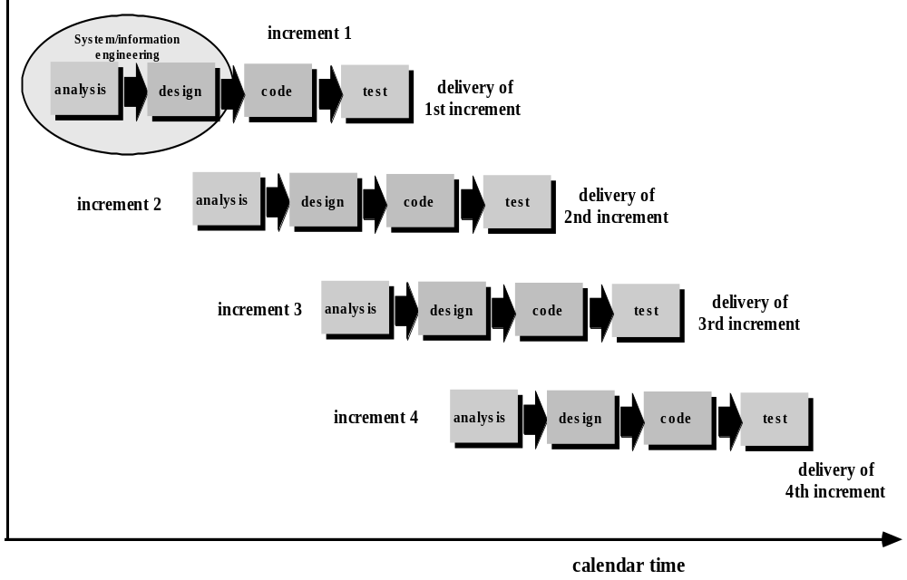
The Incremental Model

Slide 19
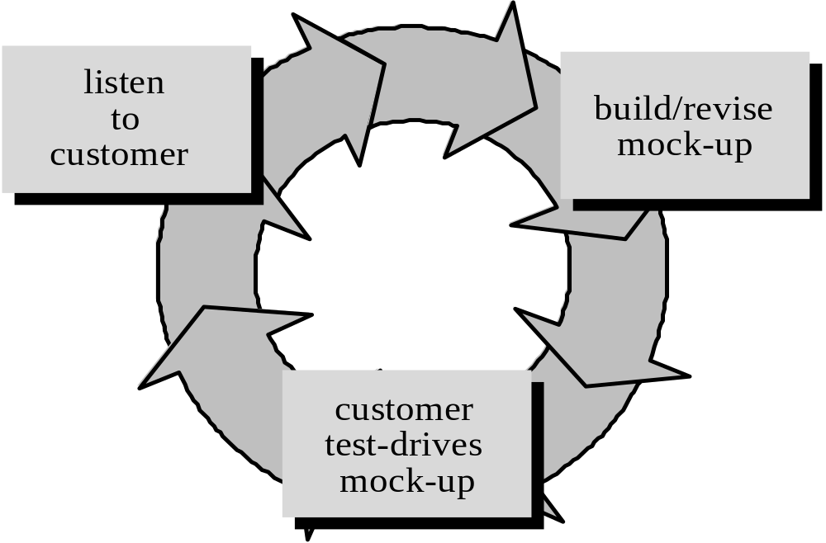
Prototyping
used to better understand user requirements
particularly suitable for user interfaces
used to establish technical feasibility
may turn into the operational system [for better or for worse]
Prototyping

Slide 20
Component assembly model
Software is composed from existing components
  developed in-house
  acquired from external sources
Object oriented technologies provide the technical framework
The process to apply when reuse is a development objective
Probably the approach with the best cost-cutting potential

Slide 21
Formal Methods and the Transformational Approach
The software is specified at a relatively high semantic level using a formal language
This formal system model is transformed into an implementation using automated or semi-automated tools
High risk because of need for advanced technology and staff skills
The specification may not be understandable to the customer or the user
The generated code may be difficult to understand and debug
Particularly useful for safety critical subsystems

Slide 22
The Transformational Model
Informal
Requirements
Transformations
Data representations
Algorithms
Optimizations
Compilation
Formal
Specification
Transform 1
Transform 2
Transform …
Transform n
Test
Formal Development Record of sequence of
transformations that have been applied

Slide 23
In the real world -
Large systems are usually made up of many sub-systems
The same life cycle model is not always used for all subsystems
Prototyping is used for user interfaces and other high-risk areas
Incremental approach is widely used [not necessarily planned]
Different parts of the project may be at different phases in the life cycle
Formal methods have not made much headway
Composition [component assembly] is becoming more realistic

